Slide 1
Machine learning: Methods and Tools
Wolfgang Ecker, Elena Zennaro, Lorenzo Servadei

Slide 2
Dimensionality Reduction

Slide 3
Outline
SVD
t-SNE
UMAP
Lecture 14 -
3

Slide 4
SVD: Singular Value Decomposition
Notes:
Announcements:
-- Enjoyed the lecture, Jeff apologizes 10 min over
-- Print the code & 10 pairs, in the ZIP include everything – the big file also
-- HW1 due Fri, max 3 late days, hand in Mon 9:30am
-- HW2 will be out Fri
-- MapReduce and Freq Itermse Gradiance quizzes due today
-- LSH quiz out! Due in 1 week!

Slide 5
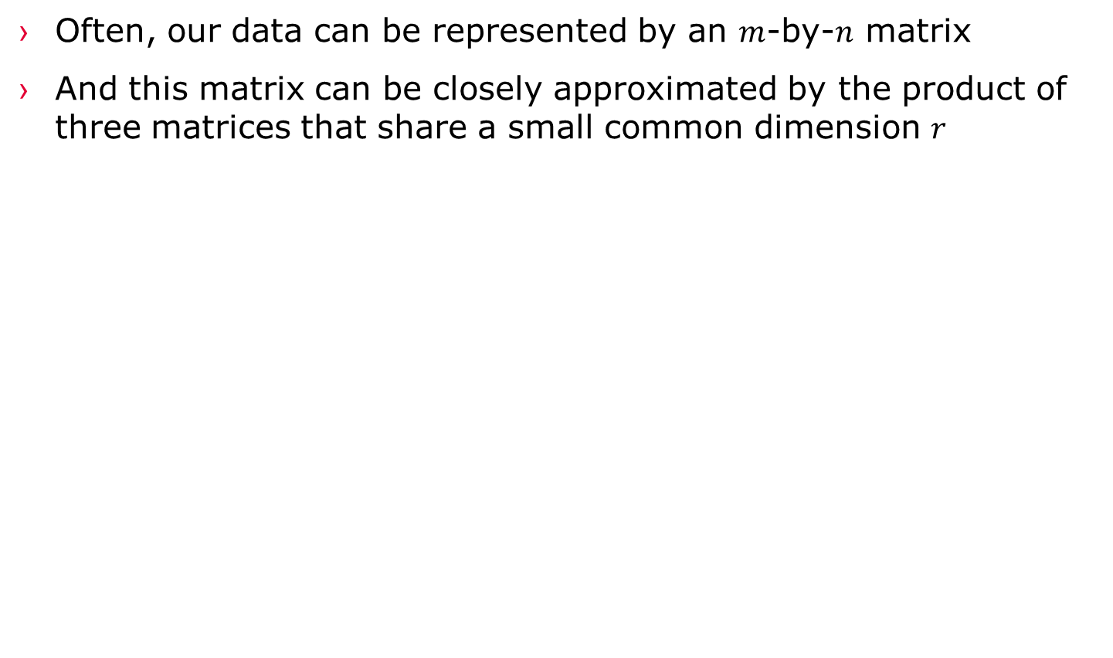
Reducing Matrix Dimension
Often, our data can be represented by an $m$-by-$n$ matrix
And this matrix can be closely approximated by the product of three matrices that share a small common dimension $r$
n
r
r
n
A
U
×
Σ
×
V^{T}
r
m
~~

Slide 6
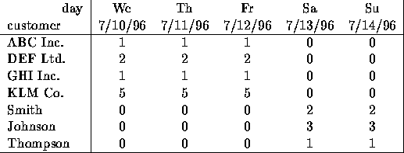
Dimensionality Reduction
Compress / reduce dimensionality:
10⁶ rows; 10³ columns; no updates
Random access to any cell(s); small error: OK
New representation
[1 0]
[2 0]
[1 0]
[5 0]
[0 2]
[0 3]
[0 1]
Note: The above matrix is really “2-dimensional.” All rows can be reconstructed by scaling [1 1 1 0 0] or [0 0 0 1 1]

Slide 7
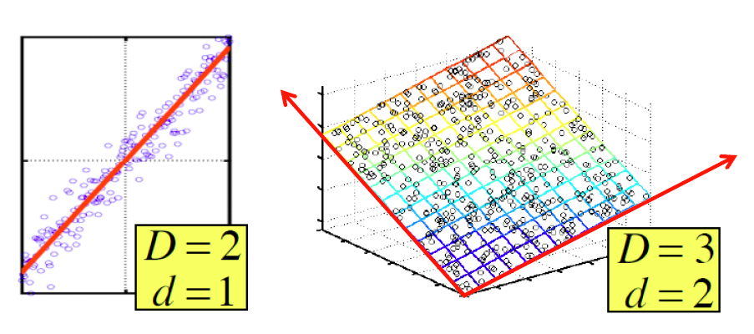
Dimensionality Reduction
There are hidden, or latent factors, latent dimensions that – to a close approximation – explain why the values are as they appear in the data matrix

Slide 8
Dimensionality Reduction
The axes of these dimensions can be chosen by:
The first dimension is the direction in which the points exhibit the greatest variance
The second dimension is the direction, orthogonal to the first, in which points show the greatest variance
And so on…, until you have enough dimensions that variance is really low

Slide 9
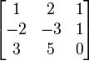
Rank is “Dimensionality”
Q: What is rank of a matrix A?
A: Number of linearly independent rows of A
Cloud of points 3D space:
Think of point positions as a matrix:
We can rewrite coordinates more efficiently!
Old basis vectors: [1 0 0] [0 1 0] [0 0 1]
New basis vectors: [1 2 1] [-2 -3 1]
Then A has new coordinates: [1 0], B: [0 1], C: [1 -1]
Notice: We reduced the number of coordinates!
A
A
B
C
1 row per point:

Slide 10
Dimensionality Reduction
Goal of dimensionality reduction is to discover the axis of data!
Rather than representing every point with 2 coordinates we represent each point with
1 coordinate (corresponding to the position of the point on the red line).
By doing this we incur a bit of error as the points do not exactly lie on the line

Slide 11
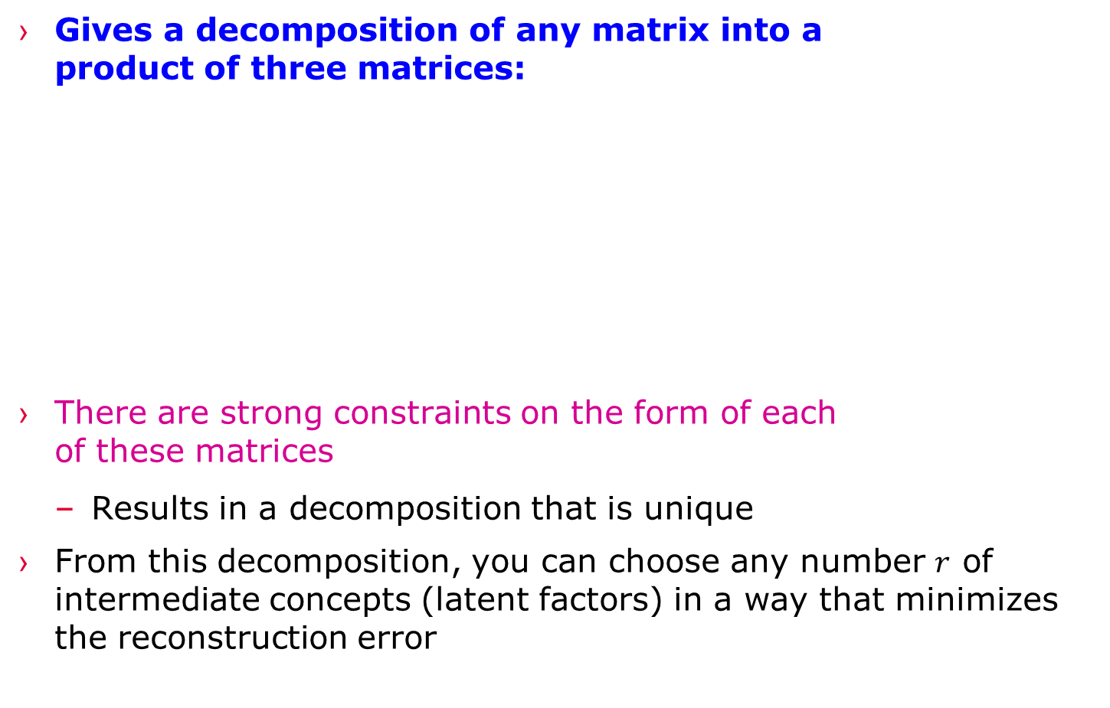
Reducing Matrix Dimension
Gives a decomposition of any matrix into a product of three matrices:
There are strong constraints on the form of each of these matrices
Results in a decomposition that is unique
From this decomposition, you can choose any number $r$ of intermediate concepts (latent factors) in a way that minimizes the reconstruction error
n
r
r
n
A
U
×
Σ
×
V^{T}
r
m
~

Slide 12
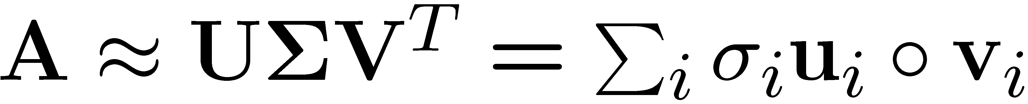
SVD - Definition
T
n
r
r
n
r
A
≈
Σ
V^{T}
m
m
U
A: Input data matrix
m x n matrix (e.g., m documents, n terms)
U: Left singular vectors
m x r matrix (m documents, r concepts)
Σ: Singular values
r x r diagonal matrix (strength of each ‘concept’) (r : rank of the matrix A)
V: Right singular vectors
n x r matrix (n terms, r concepts)

Slide 13
SVD
T
n
σ₁u₁v₁
σ₂u₂v₂
A
≈
m
+
If we set σ₂ = 0, then the green
columns may as well not exist.
σ_{i} … scalar
u_{i} … vector
v_{i} … vector

Slide 14
SVD - Properties
It is always possible to decompose a real matrix A into A = U Σ V^{T} , where
U, Σ, V: unique
U, V: column orthonormal
U^{T} U = I; V^{T} V = I (I: identity matrix)
(Columns are orthogonal unit vectors)
Σ: diagonal
Entries (singular values) are positive, and sorted in decreasing order (σ₁ ≥ σ₂ ≥ ... ≥ 0)
Nice proof of uniqueness: http://www.mpi-inf.mpg.de/~bast/ir-seminar-ws04/lecture2.pdf

Slide 15
SVD – Example: Users-to-Movies
Consider a matrix. What does SVD do?
Matrix
Alien
Serenity
Casablanca
Amelie
n
1 1 1 0 0
3 3 3 0 0
4 4 4 0 0
5 5 5 0 0
0 2 0 4 4
0 0 0 5 5
0 1 0 2 2
SciFi
Σ
V^{T}
=
m
Romance
U
“Concepts” AKA Latent dimensions AKA Latent factors

Slide 16
SVD – Example: Users-to-Movies
A = U Σ V^{T} - example: Users to Movies
Matrix
Alien
Serenity
Casablanca
Amelie
1 1 1 0 0
3 3 3 0 0
4 4 4 0 0
5 5 5 0 0
0 2 0 4 4
0 0 0 5 5
0 1 0 2 2
0.13 0.02 -0.01
0.41 0.07 -0.03
0.55 0.09 -0.04
0.68 0.11 -0.05
0.15 -0.59 0.65
0.07 -0.73 -0.67
0.07 -0.29 0.32
SciFi
12.4 0 0
0 9.5 0
0 0 1.3
=
x
x
Romance
0.56 0.59 0.56 0.09 0.09
0.12 -0.02 0.12 -0.69 -0.69
0.40 -0.80 0.40 0.09 0.09

Slide 17
SVD – Example: Users-to-Movies
A = U Σ V^{T} - example: Users to Movies
Matrix
Alien
Serenity
Casablanca
Amelie
SciFi-concept
Romance-concept
1 1 1 0 0
3 3 3 0 0
4 4 4 0 0
5 5 5 0 0
0 2 0 4 4
0 0 0 5 5
0 1 0 2 2
0.13 0.02 -0.01
0.41 0.07 -0.03
0.55 0.09 -0.04
0.68 0.11 -0.05
0.15 -0.59 0.65
0.07 -0.73 -0.67
0.07 -0.29 0.32
SciFi
12.4 0 0
0 9.5 0
0 0 1.3
=
x
x
Romance
0.56 0.59 0.56 0.09 0.09
0.12 -0.02 0.12 -0.69 -0.69
0.40 -0.80 0.40 0.09 0.09

Slide 18
SVD – Example: Users-to-Movies
U is “user-to-concept”
factor matrix
A = U Σ V^{T} - example:
Matrix
Alien
Serenity
Casablanca
Amelie
SciFi-concept
Romance-concept
1 1 1 0 0
3 3 3 0 0
4 4 4 0 0
5 5 5 0 0
0 2 0 4 4
0 0 0 5 5
0 1 0 2 2
0.13 0.02 -0.01
0.41 0.07 -0.03
0.55 0.09 -0.04
0.68 0.11 -0.05
0.15 -0.59 0.65
0.07 -0.73 -0.67
0.07 -0.29 0.32
SciFi
12.4 0 0
0 9.5 0
0 0 1.3
=
x
x
Romance
0.56 0.59 0.56 0.09 0.09
0.12 -0.02 0.12 -0.69 -0.69
0.40 -0.80 0.40 0.09 0.09

Slide 19
SVD – Example: Users-to-Movies
A = U Σ V^{T} - example:
Matrix
Alien
Serenity
Casablanca
Amelie
SciFi-concept
“strength” of the SciFi-concept
1 1 1 0 0
3 3 3 0 0
4 4 4 0 0
5 5 5 0 0
0 2 0 4 4
0 0 0 5 5
0 1 0 2 2
0.13 0.02 -0.01
0.41 0.07 -0.03
0.55 0.09 -0.04
0.68 0.11 -0.05
0.15 -0.59 0.65
0.07 -0.73 -0.67
0.07 -0.29 0.32
SciFi
SciFi
12.4 0 0
0 9.5 0
0 0 1.3
=
x
x
Romance
0.56 0.59 0.56 0.09 0.09
0.12 -0.02 0.12 -0.69 -0.69
0.40 -0.80 0.40 0.09 0.09

Slide 20
SVD – Example: Users-to-Movies
A = U Σ V^{T} - example:
Matrix
Alien
Serenity
Casablanca
Amelie
V is “movie-to-concept”
factor matrix
SciFi-concept
1 1 1 0 0
3 3 3 0 0
4 4 4 0 0
5 5 5 0 0
0 2 0 4 4
0 0 0 5 5
0 1 0 2 2
0.13 0.02 -0.01
0.41 0.07 -0.03
0.55 0.09 -0.04
0.68 0.11 -0.05
0.15 -0.59 0.65
0.07 -0.73 -0.67
0.07 -0.29 0.32
SciFi
12.4 0 0
0 9.5 0
0 0 1.3
=
x
x
Romance
0.56 0.59 0.56 0.09 0.09
0.12 -0.02 0.12 -0.69 -0.69
0.40 -0.80 0.40 0.09 0.09
SciFi-concept

Slide 21
SVD - Interpretation #1
‘movies’, ‘users’ and ‘concepts’:
U: user-to-concept matrix
V: movie-to-concept matrix
Σ: its diagonal elements: ‘strength’ of each concept

Slide 22
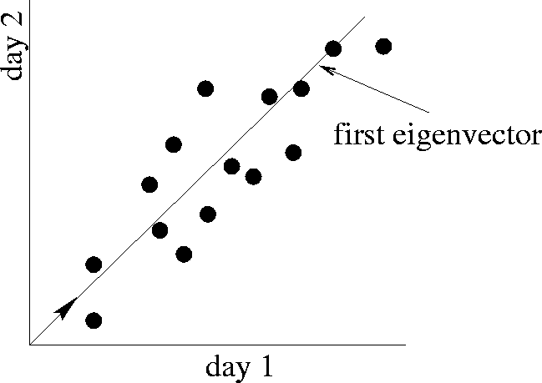
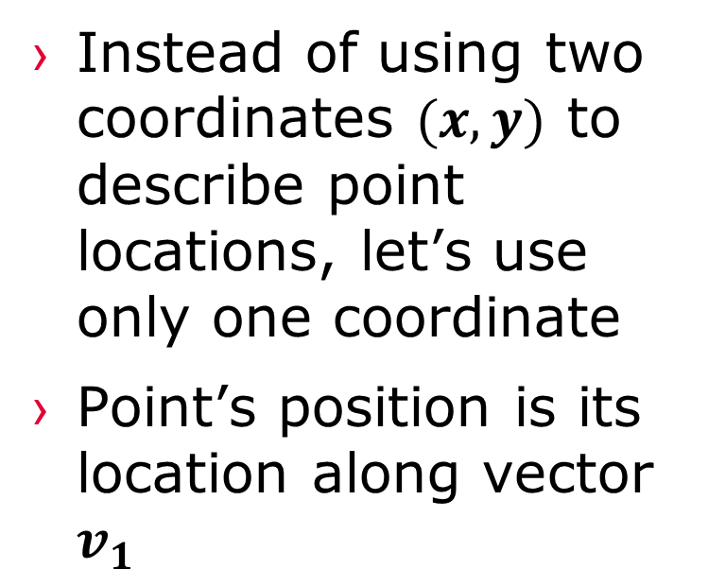
SVD – Dimensionality Reduction
Instead of using two coordinates $(x,y)$ to describe point locations, let’s use only one coordinate
Point’s position is its location along vector $v_{1}$
Movie 2 rating
first right singular vector
v₁
Movie 1 rating

Slide 23
SVD – Dimensionality Reduction
A = U Σ V^{T} - example:
V: “movie-to-concept” matrix
U: “user-to-concept” matrix
Movie 2 rating
first right singular vector
v₁
1 1 1 0 0
3 3 3 0 0
4 4 4 0 0
5 5 5 0 0
0 2 0 4 4
0 0 0 5 5
0 1 0 2 2
0.13 0.02 -0.01
0.41 0.07 -0.03
0.55 0.09 -0.04
0.68 0.11 -0.05
0.15 -0.59 0.65
0.07 -0.73 -0.67
0.07 -0.29 0.32
Movie 1 rating
12.4 0 0
0 9.5 0
0 0 1.3
=
x
x
0.56 0.59 0.56 0.09 0.09
0.12 -0.02 0.12 -0.69 -0.69
0.40 -0.80 0.40 0.09 0.09

Slide 24
SVD – Dimensionality Reduction
A = U Σ V^{T} - example:
Movie 2 rating
first right singular vector
variance (‘spread’) on the v₁ axis
v₁
1 1 1 0 0
3 3 3 0 0
4 4 4 0 0
5 5 5 0 0
0 2 0 4 4
0 0 0 5 5
0 1 0 2 2
0.13 0.02 -0.01
0.41 0.07 -0.03
0.55 0.09 -0.04
0.68 0.11 -0.05
0.15 -0.59 0.65
0.07 -0.73 -0.67
0.07 -0.29 0.32
Movie 1 rating
12.4 0 0
0 9.5 0
0 0 1.3
=
x
x
0.56 0.59 0.56 0.09 0.09
0.12 -0.02 0.12 -0.69 -0.69
0.40 -0.80 0.40 0.09 0.09

Slide 25
SVD – Dimensionality Reduction
A = U Σ V^{T} - example:
U Σ: Gives the coordinates of the points in the projection axis
Movie 2 rating
first right singular vector
v₁
1 1 1 0 0
3 3 3 0 0
4 4 4 0 0
5 5 5 0 0
0 2 0 4 4
0 0 0 5 5
0 1 0 2 2
Projection of users on the “Sci-Fi” axis (U Σ) ^{Τ}:
Movie 1 rating
1.61 0.19 -0.01
5.08 0.66 -0.03
6.82 0.85 -0.05
8.43 1.04 -0.06
1.86 -5.60 0.84
0.86 -6.93 -0.87
0.86 -2.75 0.41

Slide 26
SVD - Interpretation #2
More details
Q: How is dim. reduction done?
1 1 1 0 0
3 3 3 0 0
4 4 4 0 0
5 5 5 0 0
0 2 0 4 4
0 0 0 5 5
0 1 0 2 2
0.13 0.02 -0.01
0.41 0.07 -0.03
0.55 0.09 -0.04
0.68 0.11 -0.05
0.15 -0.59 0.65
0.07 -0.73 -0.67
0.07 -0.29 0.32
12.4 0 0
0 9.5 0
0 0 1.3
=
x
x
0.56 0.59 0.56 0.09 0.09
0.12 -0.02 0.12 -0.69 -0.69
0.40 -0.80 0.40 0.09 0.09

Slide 27
SVD - Interpretation #2
More details
Q: How exactly is dim. reduction done?
A: Set smallest singular values to zero
1 1 1 0 0
3 3 3 0 0
4 4 4 0 0
5 5 5 0 0
0 2 0 4 4
0 0 0 5 5
0 1 0 2 2
0.13 0.02 -0.01
0.41 0.07 -0.03
0.55 0.09 -0.04
0.68 0.11 -0.05
0.15 -0.59 0.65
0.07 -0.73 -0.67
0.07 -0.29 0.32
12.4 0 0
0 9.5 0
0 0 1.3
=
x
x
0.56 0.59 0.56 0.09 0.09
0.12 -0.02 0.12 -0.69 -0.69
0.40 -0.80 0.40 0.09 0.09

Slide 28
SVD - Interpretation #2
More details
Q: How exactly is dim. reduction done?
A: Set smallest singular values to zero
1 1 1 0 0
3 3 3 0 0
4 4 4 0 0
5 5 5 0 0
0 2 0 4 4
0 0 0 5 5
0 1 0 2 2
0.13 0.02 -0.01
0.41 0.07 -0.03
0.55 0.09 -0.04
0.68 0.11 -0.05
0.15 -0.59 0.65
0.07 -0.73 -0.67
0.07 -0.29 0.32
12.4 0 0
0 9.5 0
0 0 1.3
≈
x
x
0.56 0.59 0.56 0.09 0.09
0.12 -0.02 0.12 -0.69 -0.69
0.40 -0.80 0.40 0.09 0.09

Slide 29
SVD - Interpretation #2
More details
Q: How exactly is dim. reduction done?
A: Set smallest singular values to zero
This is Rank 2 approximation to A. We could also do Rank 1 approx.
The larger the rank the more accurate the approximation.
1 1 1 0 0
3 3 3 0 0
4 4 4 0 0
5 5 5 0 0
0 2 0 4 4
0 0 0 5 5
0 1 0 2 2
0.13 0.02 -0.01
0.41 0.07 -0.03
0.55 0.09 -0.04
0.68 0.11 -0.05
0.15 -0.59 0.65
0.07 -0.73 -0.67
0.07 -0.29 0.32
12.4 0 0
0 9.5 0
0 0 1.3
≈
x
x
0.56 0.59 0.56 0.09 0.09
0.12 -0.02 0.12 -0.69 -0.69
0.40 -0.80 0.40 0.09 0.09

Slide 30
SVD - Interpretation #2
More details
Q: How exactly is dim. reduction done?
A: Set smallest singular values to zero
This is Rank 2 approximation to A. We could also do Rank 1 approx.
The larger the rank the more accurate the approximation.
1 1 1 0 0
3 3 3 0 0
4 4 4 0 0
5 5 5 0 0
0 2 0 4 4
0 0 0 5 5
0 1 0 2 2
0.13 0.02
0.41 0.07
0.55 0.09
0.68 0.11
0.15 -0.59
0.07 -0.73
0.07 -0.29
12.4 0
0 9.5
≈
x
x
0.56 0.59 0.56 0.09 0.09
0.12 -0.02 0.12 -0.69 -0.69

Slide 31
SVD - Interpretation #2
More details
Q: How exactly is dim. reduction done?
A: Set smallest singular values to zero
This is Rank 2 approximation to A. We could also do Rank 1 approx.
The larger the rank the more accurate the approximation
1 1 1 0 0
3 3 3 0 0
4 4 4 0 0
5 5 5 0 0
0 2 0 4 4
0 0 0 5 5
0 1 0 2 2
0.92 0.95 0.92 0.01 0.01
2.91 3.01 2.91 -0.01 -0.01
3.90 4.04 3.90 0.01 0.01
4.82 5.00 4.82 0.03 0.03
0.70 0.53 0.70 4.11 4.11
-0.69 1.34 -0.69 4.78 4.78
0.32 0.23 0.32 2.01 2.01
≈
Reconstructed data matrix B
Frobenius norm:
ǁMǁ_{F} = √Σ_{ij} M_{ij}²
ǁA-Bǁ_{F} = √ Σ_{ij} (A_{ij}-B_{ij})²
^{is “small”}

Slide 32
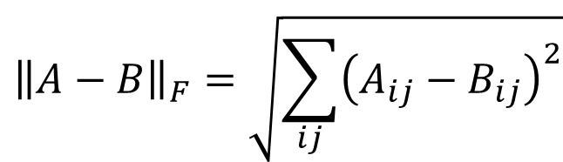
SVD – Best Low Rank Approx.
Fact: SVD gives ‘best’ axis to project on:
‘best’ = minimizing the sum of reconstruction errors
$${\left\|A−B\right\|}_{F}=\sqrt{\sum_{ij}{{\left(A_{ij}−B_{ij}\right)}^{2}}}$$
A
U
Sigma
=
V^{T}
B is best approximation of A:
B
U
Sigma
=
V^{T}

Slide 33
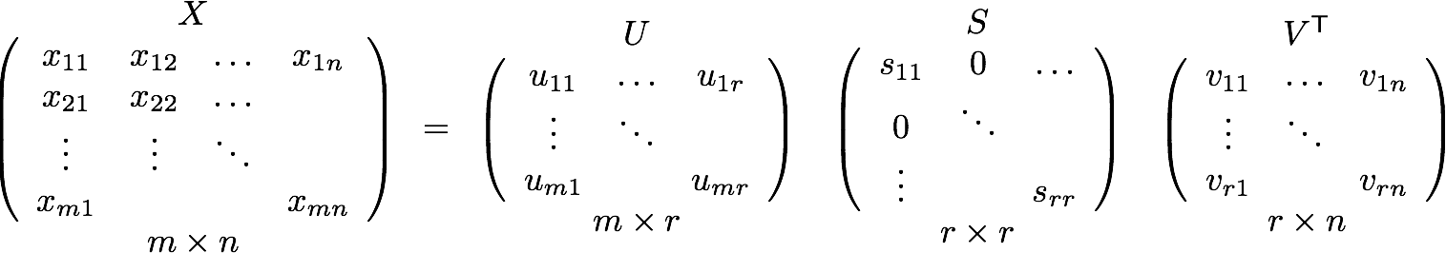
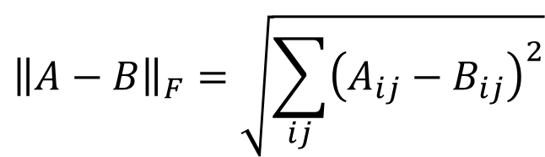
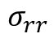
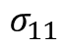
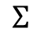
SVD – Best Low Rank Approx.
Theorem: Let A = U Σ V^{T} and B = U S V^{T} where S = diagonal rxr matrix with s_{i}=σ_{i} (i=1…k) else s_{i}=0 then B is a best rank(B)=k approx. to A
What do we mean by “best”:
B is a solution to min_{B} ǁA-Bǁ_{F} where rank(B)=k
$$Σ$$
$$σ_{11}$$
$$σ_{rr}$$
$${\left\|A−B\right\|}_{F}=\sqrt{\sum_{ij}{{\left(A_{ij}−B_{ij}\right)}^{2}}}$$
Refer to the MMDS book for a proof.
http://infolab.stanford.edu/~ullman/mmds/book.pdf
Notes:
Drop summations
USV – UXV = U-U(SV-XV)
AXC –AYC = (AC)(X-Y)

Slide 34
SVD - Conclusions so far
SVD: A= U Σ V^{T}: unique
U: user-to-concept factors
V: movie-to-concept factors
Σ : strength of each concept
Q: So what’s a good value for r?
Let the energy of a set of singular values be the sum of their squares.
Pick r so the retained singular values have at least 90% of the total energy.
Back to our example:
With singular values 12.4, 9.5, and 1.3, total energy = 245.7
If we drop 1.3, whose square is only 1.7, we are left with energy 244, or over 99% of the total

Slide 35
Example of SVD

Slide 36
Case study: How to query?
Q: Find users that like ‘Matrix’
A: Map query into a ‘concept space’ – how?
Matrix
Alien
Serenity
Casablanca
Amelie
1 1 1 0 0
3 3 3 0 0
4 4 4 0 0
5 5 5 0 0
0 2 0 4 4
0 0 0 5 5
0 1 0 2 2
0.13 0.02 -0.01
0.41 0.07 -0.03
0.55 0.09 -0.04
0.68 0.11 -0.05
0.15 -0.59 0.65
0.07 -0.73 -0.67
0.07 -0.29 0.32
SciFi
12.4 0 0
0 9.5 0
0 0 1.3
=
x
x
Romnce
0.56 0.59 0.56 0.09 0.09
0.12 -0.02 0.12 -0.69 -0.69
0.40 -0.80 0.40 0.09 0.09

Slide 37
Case study: How to query?
Q: Find users that like ‘Matrix’
A: Map query into a ‘concept space’ – how?
Matrix
Alien
Serenity
Casablanca
Amelie
Alien
q
q =
v2
v1
Project into concept space: Inner product with each ‘concept’ vector v_{i}
Matrix

Slide 38
Case study: How to query?
Q: Find users that like ‘Matrix’
A: Map query into a ‘concept space’ – how?
Matrix
Alien
Serenity
Casablanca
Amelie
Alien
q
q =
v2
v1
q*v₁
Project into concept space: Inner product with each ‘concept’ vector v_{i}
Matrix

Slide 39
Case study: How to query?
Compactly, we have:
q_{concept} = q V
E.g.:
Matrix
Alien
Serenity
Casablanca
Amelie
SciFi-concept
0.56 0.12
0.59 -0.02
0.56 0.12
0.09 -0.69
0.09 -0.69
x
=
2.8 0.6
q =
movie-to-concept
factors (V)

Slide 40
Case study: How to query?
How would the user d that rated (‘Alien’, ‘Serenity’) be handled? d_{concept} = d V
E.g.:
Matrix
Alien
Serenity
Casablanca
Amelie
SciFi-concept
0.56 0.12
0.59 -0.02
0.56 0.12
0.09 -0.69
0.09 -0.69
x
=
5.2 0.4
q =
movie-to-concept
factors (V)

Slide 41
Case study: How to query?
Observation: User d that rated (‘Alien’, ‘Serenity’) will be similar to user q that rated (‘Matrix’), although d and q have zero ratings in common!
Matrix
Alien
Serenity
Casablanca
Amelie
SciFi-concept
d =
5.2 0.4
q =
2.8 0.6
Zero ratings in common
Similarity > 0
Notes:
True since ratings are correlated and SVD uncovered this correlation

Slide 42
Relation to Eigen-decomposition
SVD gives us:
A = U Σ V^{T}
Eigen-decomposition:
A = X Λ X^{T}
A is symmetric
U, V, X are orthonormal (U^{T}U=I),
Λ, Σ are diagonal
Now let’s calculate:
AA^{T}= UΣ V^{T}(UΣ V^{T})^{T} = UΣ V^{T}(VΣ^{T}U^{T}) = UΣΣ^{T} U^{T}
A^{T}A = V Σ^{T} U^{T} (UΣ V^{T}) = V ΣΣ^{T} V^{T}
Shows how to compute SVD using eigenvalue decomposition!
X Λ² X^{T}
X Λ² X^{T}
Notes:
the columns of U are orthonormal eigenvectors of AAT
the columns of V are orthonormal eigenvectors of ATA,
S is a diagonal matrix containing the square roots of eigenvalues from U or V in descending order.
If A = A^T is a symmetric matrix, its singular values are the absolute values of its nonzero eigenvalues: σi = | λi| > 0; its singular vectors coincide with the associated non-null eigenvectors.

Slide 43
SVD: Drawbacks
Optimal low-rank approximation in terms of Frobenius norm
Interpretability problem:
A singular vector specifies a linear combination of all input columns or rows
Lack of sparsity:
Singular vectors are dense!
V^{T}
Σ
=
U

Slide 44
t-SNE (t distributed Stochastic Neighborhood Embedding)

Slide 45
t-SNE is a dimension reduction/data visualization method
Overview of t-SNE

Slide 46
Overview of t-SNE
t-SNE is a dimension reduction/data visualization method Proposed by Laurens van der Maaten & Geoffrey Hinton in 2008

Slide 47
Overview of t-SNE
t-SNE is a dimension reduction/data visualization method Proposed by Laurens van der Maaten & Geoffrey Hinton in 2008
t-SNE tends to preserve local structure at the same time preserving the global structure as much as possible

Slide 48
Here’s a basic 2-D scatter plot.

Slide 49
Here’s a basic 2-D scatter plot.
Let’s do a walk through of how t-SNE would transform this graph…

Slide 50
Here’s a basic 2-D scatter plot.
Let’s do a walk through of how t-SNE would transform this graph…
…into a flat, 1-D plot on a number line.

Slide 51
NOTE: If we just projected the data onto one of the axes, we’d just get a big mess that doesn’t preserve the original clustering.

Slide 52
Instead of two distinct clusters, we just see a mishmash.

Slide 53
Same here...

Slide 54
What t-SNE does is find a way to project data into a low dimensional space (in this case, the 1-D number line) so that the clustering in the high dimensional space (in this case, the 2-D scatter plot) is preserved.

Slide 55
So let’s step through the basic ideas of how t-SNE does this.

Slide 56
We’ll start start with the original scatter plot…

Slide 57
We’ll start start with the original scatter plot…
… then we’ll put the points on the number line in a random order.

Slide 58
From here on out, t-SNE moves these points, a little bit at a time, until it has clustered them.

Slide 59
Let’s figure out where to move this first point…

Slide 60
Let’s figure out where to move this first point…
Should it move a little to the left or a little to the right?

Slide 61
Because it is part of this cluster…

Slide 62
Because it is part of this cluster…
…it wants to move closer to these points.

Slide 63
But at the same time, these points…

Slide 64
But at the same time, these points…
…are far away in the scatter plot…

Slide 65
But at the same time, these points… …are far away in the scatter plot…
…so they push back.

Slide 66
These points attract…

Slide 67
These points attract…
…while these points repel.

Slide 68
In this case, the attraction is strongest, so the point moves a little to the right.

Slide 69
In this case, the attraction is strongest, so the point moves a little to the right.

Slide 70
BAM!

Slide 71
Now let’s move this point a little bit…

Slide 72
These points attract…

Slide 73
These points attract…
…and this point repels a little bit.

Slide 74
So it moves a little to closer to the other orange points.

Slide 76
At each step, a point on the line is attracted to points it is near in the scatter plot, and repelled by points it is far from…

Slide 77
At each step, a point on the line is attracted to points it is near in the scatter plot, and repelled by points it is far from…

Slide 78
At each step, a point on the line is attracted to points it is near in the scatter plot, and repelled by points it is far from…

Slide 79
At each step, a point on the line is attracted to points it is near in the scatter plot, and repelled by points it is far from…

Slide 80
At each step, a point on the line is attracted to points it is near in the scatter plot, and repelled by points it is far from…

Slide 81
At each step, a point on the line is attracted to points it is near in the scatter plot, and repelled by points it is far from…

Slide 82
At each step, a point on the line is attracted to points it is near in the scatter plot, and repelled by points it is far from…

Slide 83
At each step, a point on the line is attracted to points it is near in the scatter plot, and repelled by points it is far from…

Slide 84
At each step, a point on the line is attracted to points it is near in the scatter plot, and repelled by points it is far from…

Slide 85
At each step, a point on the line is attracted to points it is near in the scatter plot, and repelled by points it is far from…

Slide 86
At each step, a point on the line is attracted to points it is near in the scatter plot, and repelled by points it is far from…

Slide 87
At each step, a point on the line is attracted to points it is near in the scatter plot, and repelled by points it is far from…

Slide 88
At each step, a point on the line is attracted to points it is near in the scatter plot, and repelled by points it is far from…

Slide 89
At each step, a point on the line is attracted to points it is near in the scatter plot, and repelled by points it is far from…

Slide 90
At each step, a point on the line is attracted to points it is near in the scatter plot, and repelled by points it is far from…

Slide 91
At each step, a point on the line is attracted to points it is near in the scatter plot, and repelled by points it is far from…

Slide 92
At each step, a point on the line is attracted to points it is near in the scatter plot, and repelled by points it is far from…

Slide 93
At each step, a point on the line is attracted to points it is near in the scatter plot, and repelled by points it is far from…

Slide 94
At each step, a point on the line is attracted to points it is near in the scatter plot, and repelled by points it is far from…

Slide 95
At each step, a point on the line is attracted to points it is near in the scatter plot, and repelled by points it is far from…

Slide 96
At each step, a point on the line is attracted to points it is near in the scatter plot, and repelled by points it is far from…

Slide 97
At each step, a point on the line is attracted to points it is near in the scatter plot, and repelled by points it is far from…

Slide 98
At each step, a point on the line is attracted to points it is near in the scatter plot, and repelled by points it is far from…

Slide 99
At each step, a point on the line is attracted to points it is near in the scatter plot, and repelled by points it is far from…

Slide 100
At each step, a point on the line is attracted to points it is near in the scatter plot, and repelled by points it is far from…

Slide 101
At each step, a point on the line is attracted to points it is near in the scatter plot, and repelled by points it is far from…

Slide 102
At each step, a point on the line is attracted to points it is near in the scatter plot, and repelled by points it is far from…

Slide 103
At each step, a point on the line is attracted to points it is near in the scatter plot, and repelled by points it is far from…

Slide 104
At each step, a point on the line is attracted to points it is near in the scatter plot, and repelled by points it is far from…

Slide 105
At each step, a point on the line is attracted to points it is near in the scatter plot, and repelled by points it is far from…

Slide 106
At each step, a point on the line is attracted to points it is near in the scatter plot, and repelled by points it is far from…

Slide 107
At each step, a point on the line is attracted to points it is near in the scatter plot, and repelled by points it is far from…

Slide 109
Now that we’ve seen the what t-SNE tries to do, let’s dive into the nitty-gritty details of how it does what it does.

Slide 110
Step 1: Determine the “similarity” of all the points in the scatter plot.

Slide 111
Step 1: Determine the “similarity” of all the points in the scatter plot.
For this example, let’s focus on determining the similarities between this point and all of the other points.

Slide 112
First, measure the distance between two points…

Slide 113
First, measure the distance between two points…
Then plot that distance on a normal curve that is centered on the point of interest…

Slide 114
First, measure the distance between two points…
Then plot that distance on a normal curve that is centered on the point of interest…
…lastly, draw a line from the point to the curve. The length of that line is the “unscaled similarity”.

Slide 115
First, measure the distance between two points…
Then plot that distance on a normal curve that is centered on the point of interest…
…lastly, draw a line from the point to the curve. The length of that line is the “unscaled similarity”.
(I made that terminology up, but it will make sense in just a bit!)

Slide 116
Now we calculate the “unscaled similarity” for this pair of points.

Slide 117
Now we calculate the “unscaled similarity” for this pair of points.

Slide 118
Now we calculate the “unscaled similarity” for this pair of points.

Slide 119
Now we calculate the “unscaled similarity” for this pair of points.

Slide 120
Now we calculate the “unscaled similarity” for this pair of points.

Slide 121
Now we calculate the “unscaled similarity” for this pair of points.

Slide 122
Now we calculate the “unscaled similarity” for this pair of points.
Etc. etc…

Slide 123
Using a normal distribution means that distant points have very low similarity values….

Slide 124
… and close points have high similarity values.

Slide 125
Ultimately, we measure the distances between all of the points and the point of interest…

Slide 126
Ultimately, we measure the distances between all of the points and the point of interest…
Plot them on the normal curve…

Slide 127
Ultimately, we measure the distances between all of the points and the point of interest…
…and then measure the distances from the points to the curve to get the unscaled similarity scores with respect to the point of interest.
Plot them on the normal curve…

Slide 128
The next step is to scale the unscaled similarities so that they add up to 1.

Slide 129
The next step is to scale the unscaled similarities so that they add up to 1.
Umm… Why do the similarity scores need to add up to 1?

Slide 130
It has to do with something I didn’t tell you earlier…

Slide 131
It has to do with something I didn’t tell you earlier…
…and to illustrate the concept, I need to add a cluster that is half as dense as the others.

Slide 132
The width of the normal curve depends on the density of data near the point of interest.

Slide 133
The width of the normal curve depends on the density of data near the point of interest.
Less dense regions have wider curves.

Slide 134
…so if these points… have half the density as these points…

Slide 135
…so if these points… have half the density as these points…

Slide 136
…so if these points… have half the density as these points…
…and this curve…
is half as wide

Slide 137
…so if these points… have half the density as these points…
…and this curve…
is half as wide as
this curve…

Slide 138
…so if these points… have half the density as these points…
…and this curve…
is half as wide as
this curve…
…then scaling the similarity scores will make them the same for both clusters.

Slide 139
Here’s an example…

Slide 140
Here’s an example…
This curve has a standard deviation = 1.

Slide 141
Here’s an example…
This curve has a standard deviation = 1.
= 0.24
The “unscaled” similarity values
= 0.05

Slide 142
Here’s an example…
This curve has a standard deviation = 1.
= 0.24
The “unscaled” similarity values
= 0.05
This curve has a standard deviation = 2.

Slide 143
Here’s an example…
This curve has a standard deviation = 1.
= 0.24
The “unscaled” similarity values
= 0.05
This curve has a standard deviation = 2.
= 0.12
= 0.024
These points are twice as far from the middle.

Slide 144
= 0.24
= 0.05
To scale the similarity scores so they sum to 1:
Score
= Scaled Score
Sum of all scores
= 0.12
= 0.024

Slide 145
0.24
= 0.82
= 0.24
0.24 + 0.05
0.05
= 0.18
= 0.05
0.24 + 0.05
To scale the similarity scores so they sum to 1:
Score
= Scaled Score
Sum of all scores
= 0.12
= 0.024

Slide 146
To scale the similarity scores so they sum to 1:
0.24
= 0.82
= 0.24
0.24 + 0.05
Score
0.05
= Scaled Score
= 0.18
Sum of all scores
0.24 + 0.05
= 0.05
0.12
= 0.82
0.12 + 0.024
= 0.12
= 0.024
0.024
= 0.18
0.12 + 0.024

Slide 147
To scale the similarity scores so they sum to 1:
0.24
= 0.82
= 0.24
0.24 + 0.05
Score
0.05
= Scaled Score
= 0.18
Sum of all scores
0.24 + 0.05
= 0.05
These are the same as these!
0.12
= 0.82
0.12 + 0.024
= 0.12
0.024
= 0.024
= 0.18
0.12 + 0.024

Slide 148
That implies that the scaled similarity scores for this relatively tight cluster…
0.24
= 0.82
0.24 + 0.05
0.05
= 0.18
0.24 + 0.05
0.12
= 0.82
0.12 + 0.024
0.024
= 0.18
0.12 + 0.024

Slide 149
That implies that the scaled similarity scores for this relatively tight cluster…
0.24
= 0.82
0.24 + 0.05
0.05
= 0.18
…are the same for this relatively loose cluster!
0.24 + 0.05
0.12
= 0.82
0.12 + 0.024
0.024
= 0.18
0.12 + 0.024

Slide 150
The reality is a little more complicated, but only slightly.

Slide 151
The reality is a little more complicated, but only slightly.
t-SNE has a “perplexity” parameter equal to the expected density, and that comes into play, but these clusters are still more “similar” than you might expect.

Slide 152
Now back to the original scatter plot…

Slide 153
We’ve calculated similarity scores for this point.

Slide 154
Now we do it for this point…

Slide 155
Now we do it for this point…
…and we do it for all the points.

Slide 156
One last thing and the scatter plot will be all set with similarity scores!!!

Slide 157
Because the width of the distribution is based on the density of the surrounding data points, the similarity score to this node…

Slide 158
…might not be the same as the similarity to this node.

Slide 159
So t-SNE just averages the two similarity scores from the two directions…

Slide 160
So t-SNE just averages the two similarity scores from the two directions…
No big deal!

Slide 161
= High similarity
= Low similarity
Ultimately, you end up with a matrix of similarity scores.

Slide 162
= High similarity
= Low similarity

Slide 163
= High similarity
= Low similarity
We’re done doing calculating similarity scores for the scatter plot!

Slide 164
Now we randomly project the data onto the number line…

Slide 165
Now we randomly project the data onto the number line…
… and calculate similarity scores for the points on the number line.

Slide 166
Just like before, that means picking a point…

Slide 167
Just like before, that means picking a point…
…measuring a distance…

Slide 168
…and lastly, drawing a line from the point to a curve. However, this time we’re using a “t-distribution”.
Just like before, that means picking a point…
…measuring a distance…

Slide 169
A “t-distribution”…

Slide 170
A “t-distribution”…
…is a lot like a normal distribution

Slide 171
…except the “t” isn’t as tall in the middle…
A “t-distribution”…
…is a lot like a normal distribution…

Slide 172
…except the “t” isn’t as tall in the middle…
… and the tails are taller on the ends.
A “t-distribution”…
…is a lot like a normal distribution…

Slide 173
…except the “t” isn’t as tall in the middle…
… and the tails are taller on the ends.
A “t-distribution”…
…is a lot like a normal distribution…
The “t-distribution” is the “t” in t-SNE.

Slide 174
…except the “t” isn’t as tall in the middle…
… and the tails are taller on the ends.
A “t-distribution”…
…is a lot like a normal distribution…
The “t-distribution” is the “t” in t-SNE.
We’ll talk about why the t-distribution is used in a bit…

Slide 175
So, using a t-distribution, we calculate “unscaled” similarity scores for all the points and then scale them like before.

Slide 176
= High similarity
= Low similarity
Like before, we end up with a matrix of similarity scores, but this matrix is a mess…

Slide 177
= High similarity
= High similarity
= Low similarity
= Low similarity
…compared to the original matrix.
Like before, we end up with a matrix of similarity scores, but this matrix is a mess…

Slide 178
The goal of moving this point is…

Slide 179
we want to make this row…
The goal of moving this point is…

Slide 180
we want to make this row…
look like this row.
The goal of moving this point is…

Slide 181
t-SNE moves the points a little bit at a time, and each step it chooses a direction that makes the matrix on the left more like the matrix on the right.

Slide 182
t-SNE moves the points a little bit at a time, and each step it chooses a direction that makes the matrix on the left more like the matrix on the right.

Slide 183
t-SNE moves the points a little bit at a time, and each step it chooses a direction that makes the matrix on the left more like the matrix on the right.
It uses small steps, because it’s a little bit like a chess game and can’t be solved all at once. Instead, it goes one move at at time.

Slide 185
Now to finally tell you why the “t-distribution” is used…

Slide 186
…originally, the “SNE” algorithm just used a normal distribution throughout and the clusters clumped up in the middle and were harder to see.

Slide 187
The t-distribution forces some space between the points.

Slide 189
SNE (Stochastic Neighbor Embedding)
Aim is to match distributions of distances between points in high and low dimensional space via conditional probabilities

Slide 190
SNE (Stochastic Neighbor Embedding)
Aim is to match distributions of distances between points in high and low dimensional space via conditional probabilities
Assume distances in both high and low dimensional space are Gaussian-distributed

Slide 191
SNE
Let x_{i} be the i ^{th} object in high dimensional space

Slide 192
Let x_{i} be the i ^{th} object in high dimensional space Let y_{i} be the i ^{th} object in low dimensional space
SNE

Slide 193
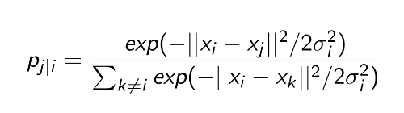
Let x_{i} be the i ^{th} object in high dimensional space Let y_{i} be the i ^{th} object in low dimensional space
SNE
Construct:

Slide 194
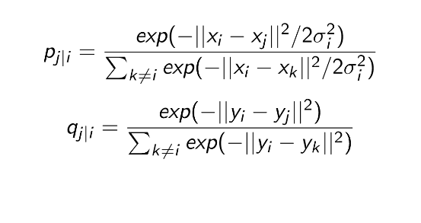
Let x_{i} be the i ^{th} object in high dimensional space Let y_{i} be the i ^{th} object in low dimensional space
SNE
Construct:

Slide 195
Let x_{i} be the i ^{th} object in high dimensional space Let y_{i} be the i ^{th} object in low dimensional space
SNE
Construct:
^{p}i |i ^{= q}i |i ⁼ ⁰

Slide 196
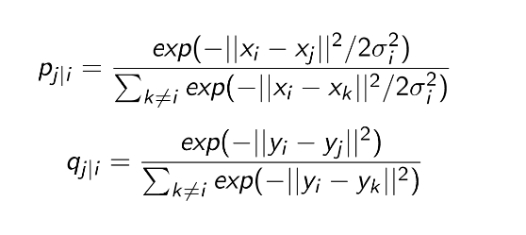
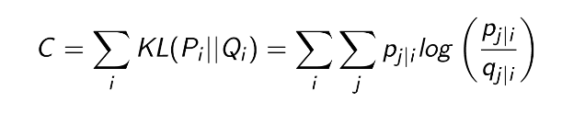
Let x_{i} be the i ^{th} object in high dimensional space Let y_{i} be the i ^{th} object in low dimensional space
SNE
Construct:
^{p}i |i ^{= q}i |i ⁼ ⁰
Match these functions by minimizing sum of Kullback-Leibler divergences:

Slide 197
Since KL divergence is asymmetric,
SNE
large cost for representing nearby data points in high dimensional map by widely separated points in the low dimensional map
smaller coast for representing widely separated data points in high dimensional map by nearby points in the low dimension

Slide 198
Since KL divergence is asymmetric,
SNE
large cost for representing nearby data points in high dimensional map by widely separated points in the low dimensional map
smaller coast for representing widely separated data points in high dimensional map by nearby points in the low dimension
Hence local structure is highly preserved

Slide 199
Since KL divergence is asymmetric,
SNE
large cost for representing nearby data points in high dimensional map by widely separated points in the low dimensional map
smaller coast for representing widely separated data points in high dimensional map by nearby points in the low dimension
Hence local structure is highly preserved
σ_{i} is associated with a parameter called perplexity which can be loosely interpreted as the number of close neighbors each point has

Slide 200
Since KL divergence is asymmetric,
SNE
large cost for representing nearby data points in high dimensional map by widely separated points in the low dimensional map
smaller coast for representing widely separated data points in high dimensional map by nearby points in the low dimension
Hence local structure is highly preserved
σ_{i} is associated with a parameter called perplexity which can be loosely interpreted as the number of close neighbors each point has
σ_{i} is found via binary search (More in the paper)

Slide 201
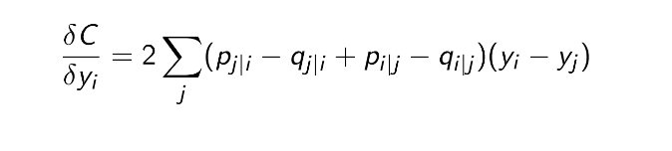
Since KL divergence is asymmetric,
SNE
large cost for representing nearby data points in high dimensional map by widely separated points in the low dimensional map
smaller coast for representing widely separated data points in high dimensional map by nearby points in the low dimension
Hence local structure is highly preserved
σ_{i} is associated with a parameter called perplexity which can be loosely interpreted as the number of close neighbors each point has
σ_{i} is found via binary search (More in the paper) Gradient of the cost function

Slide 202
Given the cost function SNE uses gradient descent for optimization
SNE optimization

Slide 203
SNE optimization
Given the cost function SNE uses gradient descent for optimization
In addition to the gradient of the cost function it also has a momentum term to speed up the optimization and to avoid local optima

Slide 204
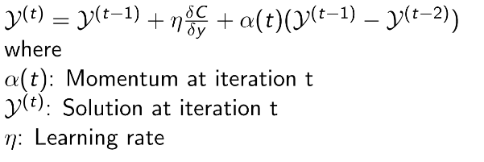
SNE optimization
Given the cost function SNE uses gradient descent for optimization
In addition to the gradient of the cost function it also has a momentum term to speed up the optimization and to avoid local optima

Slide 205
Drawbacks of SNE and novel features of t-SNE
SNE has two main drawbacks:
Cost function is difficult to optimize Crowding problem

Slide 206
Drawbacks of SNE and novel features of t-SNE
SNE has two main drawbacks:
Cost function is difficult to optimize Crowding problem
Novel features in t-SNE
t-SNE cost function has two distinct features:
Cost function is symmetrized version of that in SNE. i.e. (p_{i |j} = p_{j |i}
Student t-distribution is used to compute the similarities between data points in the low dimensional space.
and q_{i |j} = q_{j |i} )

Slide 207
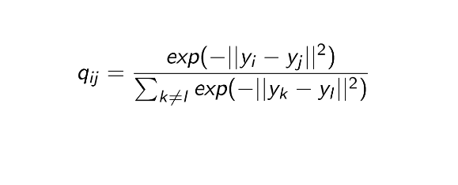
Symmetric SNE
The main feature in symmetric SNE is that p_{ij} =p_{ji} and p_{ii} =q_{ii} =0 for all i,j

Slide 208
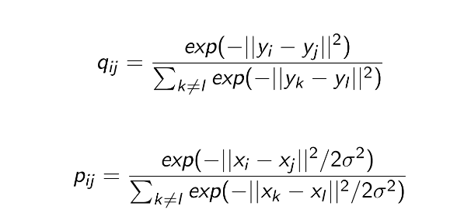
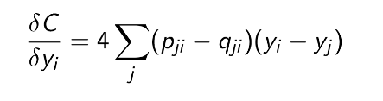
Symmetric SNE
The main feature in symmetric SNE is that p_{ij} = p_{ji} and p_{ii} = q_{ii} = 0 for all i,j
Gradient of the cost function:

Slide 209
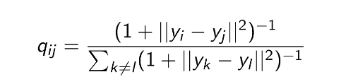
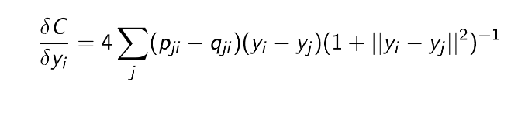
t-SNE mapping
In t-SNE a student t distribution with one degree of freedom (Cauchy distribution) is used to represent the low dimensional map:
t-distribution is robust to outliers and unlike a Gaussian distribution it doesn’t have exponent in it so faster to evaluate
Gradient of the cost function:

Slide 210
t-SNE algorithm
The general idea of t-SNE algorithm:
Data: data set X with data points = x₁, x₂, ..., x_{n} each of these points have very high dimension

Slide 211
t-SNE algorithm
The general idea of t-SNE algorithm:
Data: data set X with data points = x₁, x₂, ..., x_{n} each of these points have very high dimension
cost function parameter: Perplexity Perp, perplexity is associated with variance σ in the cost function

Slide 212
t-SNE algorithm
The general idea of t-SNE algorithm:
Data: data set X with data points = x₁, x₂, ..., x_{n} each of these points have very high dimension
cost function parameter: Perplexity Perp, perplexity is associated with variance σ in the cost function
Optimization parameters: number of iterations T , learning rate η, momentum α(t)

Slide 213
t-SNE algorithm
t-SNE algorithm: begin
Compute pairwise affinities p_{j |i} with perplexity Perp

Slide 214
t-SNE algorithm
t-SNE algorithm: begin
Compute pairwise affinities p_{j |i} with perplexity Perp
^{p}i |j ^{+p}j |i
Set p = (n - Number of data points)
ij
2n

Slide 215
t-SNE algorithm
t-SNE algorithm: begin
Compute pairwise affinities p_{j |i} with perplexity Perp
^{p}i |j ^{+p}j |i
Set p = (n - Number of data points)
ij
2n
Sample initial solution Y ⁽⁰⁾ = y₁, y₂, ..., y_{n} from N(0, 10⁻⁴I )
for t=1 to T do
Compute low-dimensional affinities q_{ij}

Slide 216
t-SNE algorithm
t-SNE algorithm: begin
Compute pairwise affinities p_{j |i} with perplexity Perp
^{p}i |j ^{+p}j |i
Set p = (n - Number of data points)
ij
2n
Sample initial solution Y ⁽⁰⁾ = y₁, y₂, ..., y_{n} from N(0, 10⁻⁴I )
for t=1 to T do
Compute low-dimensional affinities q_{ij}
Compute gradient ^{δC}
δy

Slide 217
t-SNE algorithm
t-SNE algorithm: begin
Compute pairwise affinities p_{j |i} with perplexity Perp
^{p}i |j ^{+p}j |i
Set p = (n - Number of data points)
ij
2n
Sample initial solution Y ⁽⁰⁾ = y₁, y₂, ..., y_{n} from N(0, 10⁻⁴I )
for t=1 to T do
Compute low-dimensional affinities q_{ij}
Compute gradient ^{δC}
δy
(t) (t−1) δC
(t−1) (t−2)
Set Y = Y + η + α(t)(
Y − Y )
end
end
δy

Slide 218
Criticism of t-SNE
There is a great paper by Wattenberg, Viegas and Johnson titled How to Use t-SNE Effectively, it explains some of the drawbacks of t-SNE with some interactive visualization tools
Different perplexity can lead to completely different clusters (too small - local variations dominate, too large - global change dominate)

Slide 219
Criticism of t-SNE
There is a great paper by Wattenberg, Viegas and Johnson titled How to Use t-SNE Effectively, it explains some of the drawbacks of t-SNE with some interactive visualization tools
Different perplexity can lead to completely different clusters (too small - local variations dominate, too large - global change dominate)
Cluster size doesn’t have any meaning to it. Naturally expands dense cluster and contracts sparse cluster

Slide 220
Criticism of t-SNE
There is a great paper by Wattenberg, Viegas and Johnson titled How to Use t-SNE Effectively, it explains some of the drawbacks of t-SNE with some interactive visualization tools
Different perplexity can lead to completely different clusters (too small - local variations dominate, too large - global change dominate)
Cluster size doesn’t have any meaning to it. Naturally expands dense cluster and contracts sparse cluster
Distance between clusters might not have clear interpretation

Slide 221
Criticism of t-SNE
There is a great paper by Wattenberg, Viegas and Johnson titled How to Use t-SNE Effectively, it explains some of the drawbacks of t-SNE with some interactive visualization tools
Different perplexity can lead to completely different clusters (too small - local variations dominate, too large - global change dominate)
Cluster size doesn’t have any meaning to it. Naturally expands dense cluster and contracts sparse cluster
Distance between clusters might not have clear interpretation
Sometime random noise can lead to false positive structure in the t-SNE projection

Slide 222

UMAP
Uniform Manifold Approximation and Projection for dimension reduction

Slide 223
Find the “latent” features in your data

Slide 224
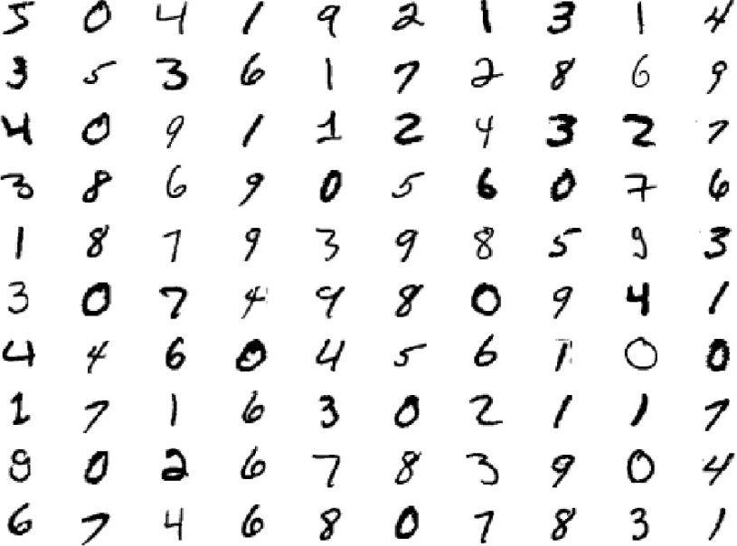

Slide 225
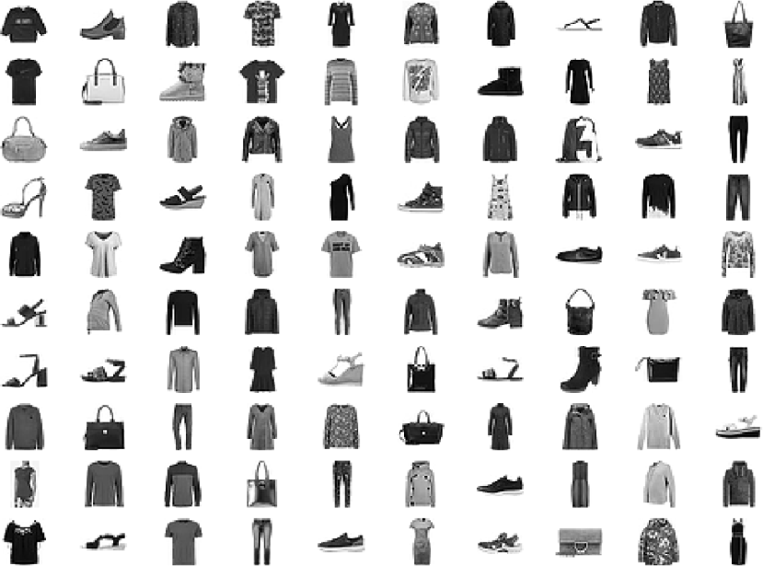

Slide 226
Matrix Factorization
Neighbour Graphs

Slide 227
Matrix Factorization
Principal Component Analysis
Linear Autoencoder Latent Dirichlet Allocation
Non-negative Matrix Factorization
Generalised Low Rank Models Word2Vec GloVe

Slide 228
Neighbour Graphs
Laplacian Eigenmaps
Hessian Eigenmaps Local Tangent Space Alignment
JSE Isomap
Locally Linear Embedding
t-SNE
UMAP

Slide 229
PCA is the prototypical matrix factorization

Slide 230
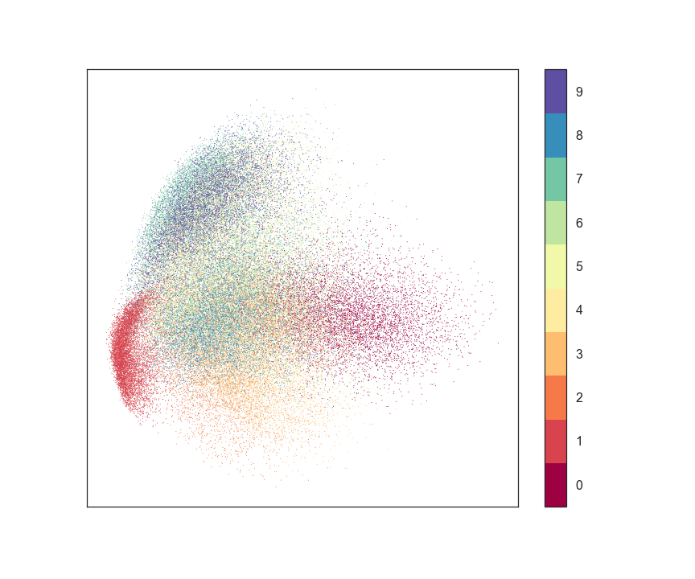
PCA on MNIST digits

Slide 231
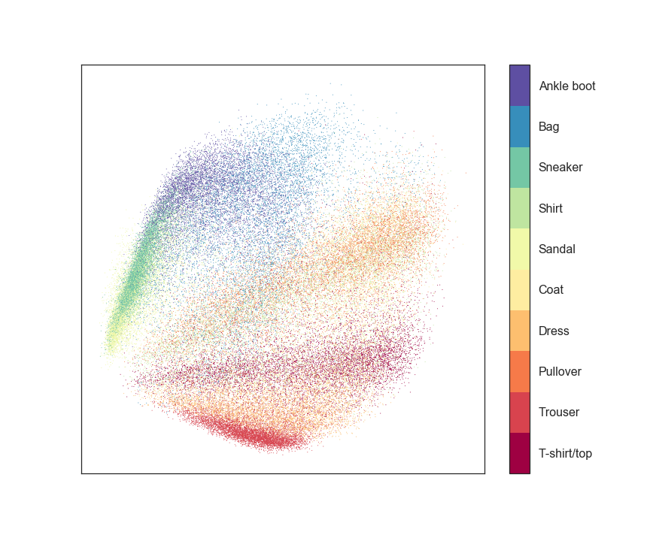
PCA on Fashion MNIST

Slide 232
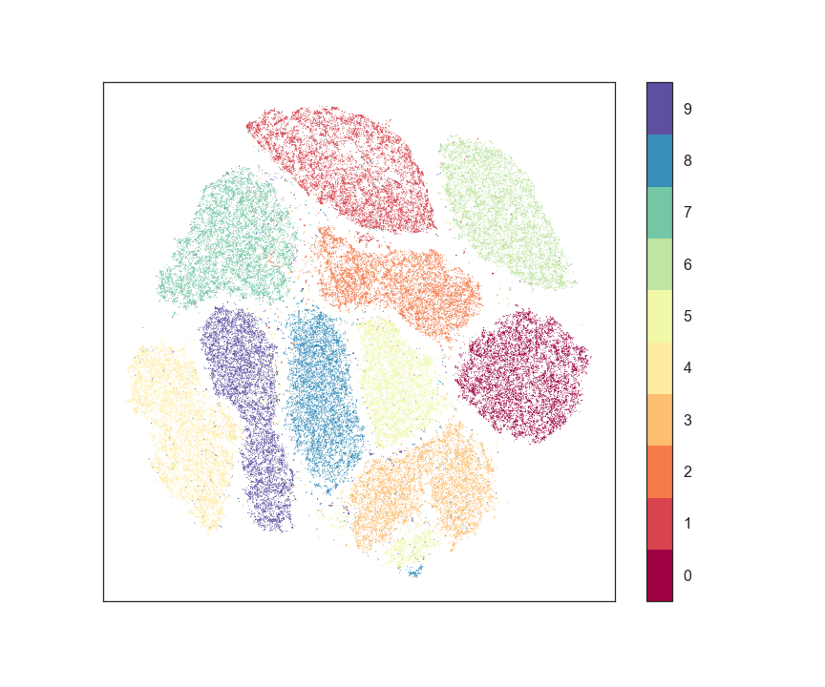
t-SNE on MNIST digits

Slide 233
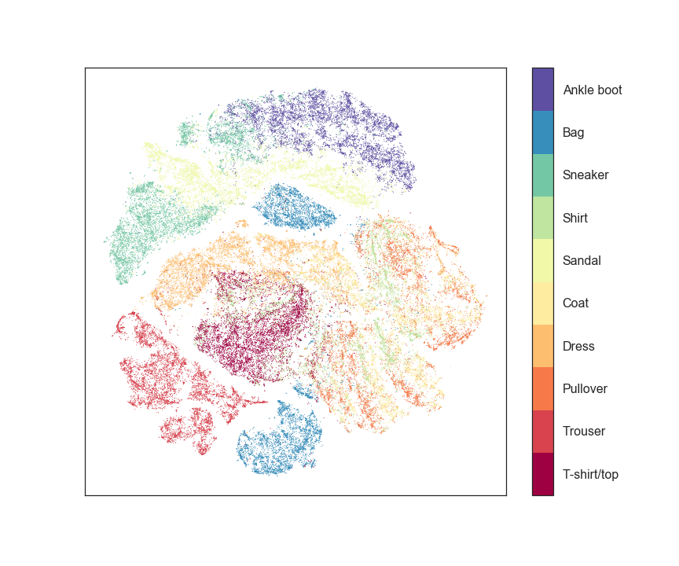
t-SNE on Fashion MNIST

Slide 234
UMAP builds mathematical theory to justify the graph based approach

Slide 235
First, a little bit of topological data analysis…

Slide 236
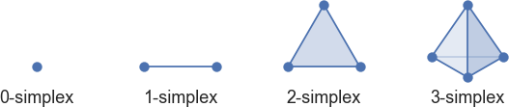
Simplices

Slide 237
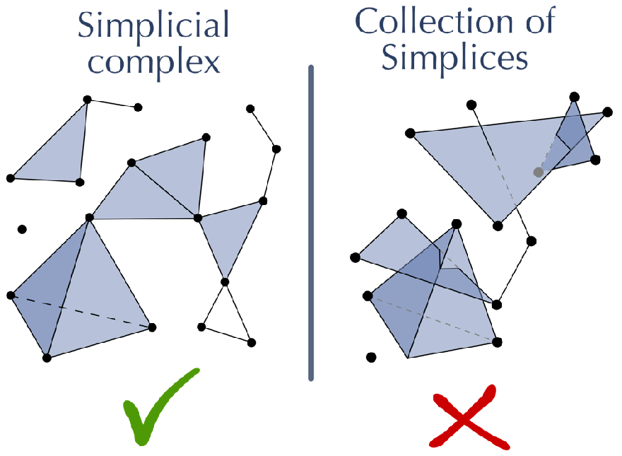

Slide 238
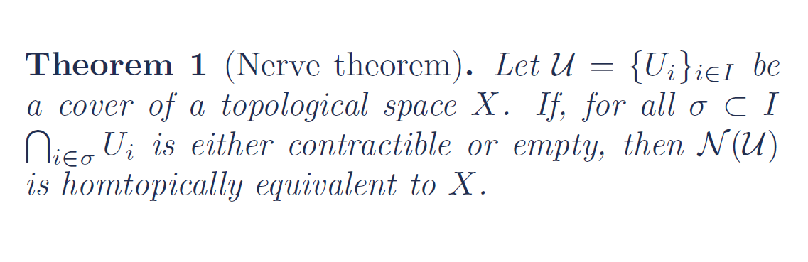

Slide 239
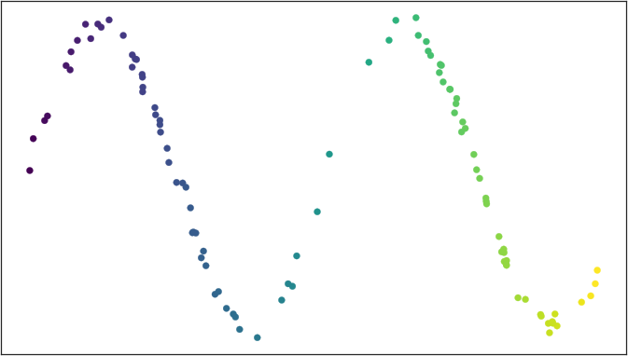

Slide 240
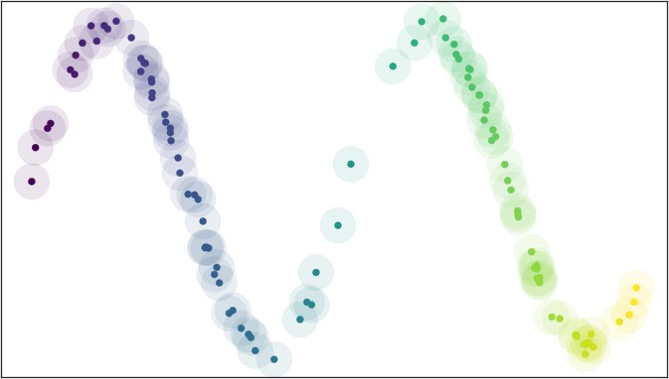

Slide 241
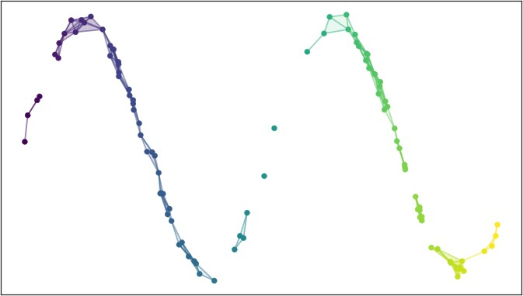

Slide 242
If the data is uniformly distributed on the manifold then the cover will be “good”

Slide 243
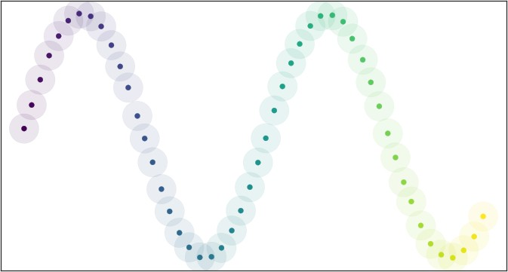

Slide 244
When is data that nicely behaved?

Slide 245
Assumption: Data is uniformly distributed on the manifold

Slide 246
Define a Riemannian metric on the manifold to make this assumption true

Slide 247
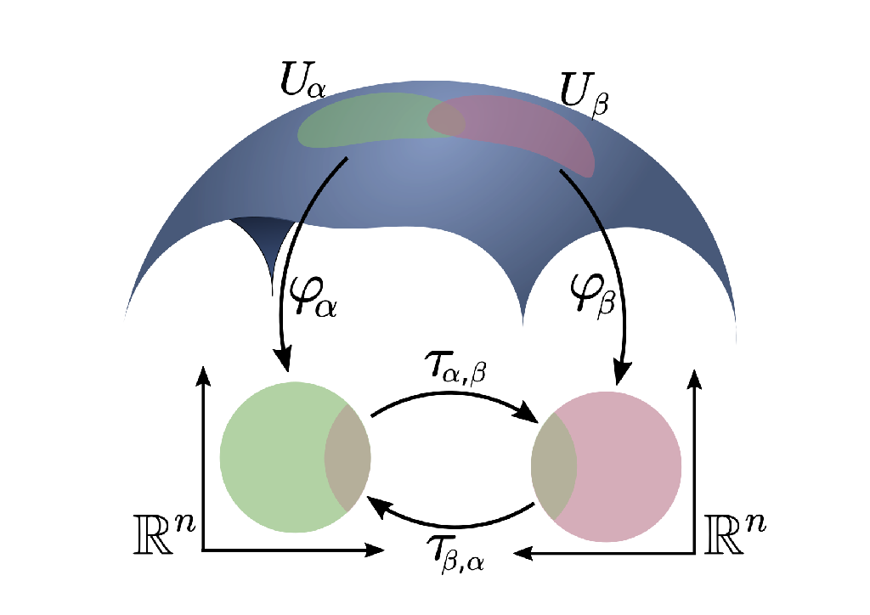

Slide 248
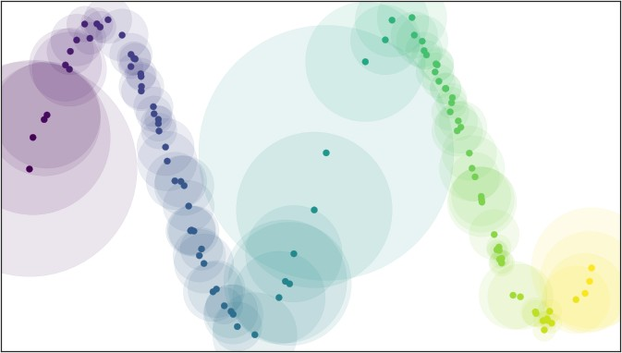

Slide 249
Why choose a fixed radius? Why not have a fuzzy cover?

Slide 250
Theorem 2 (UMAP Adjunction). The functors FinReal : sFuzz ! FinEPMet and FinSing : FinEPMet ! sFuzz form an adjunction FinReal a FinSing.

Slide 251
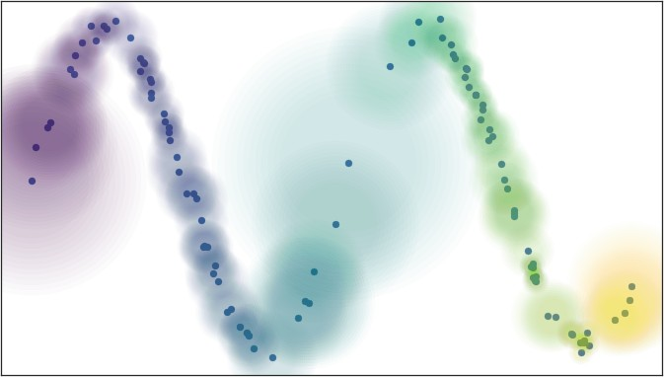

Slide 252
Assumption:
The manifold is locally connected

Slide 253
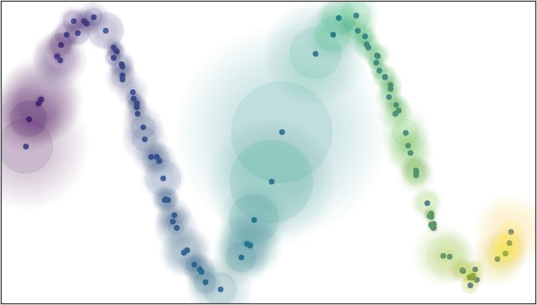

Slide 254
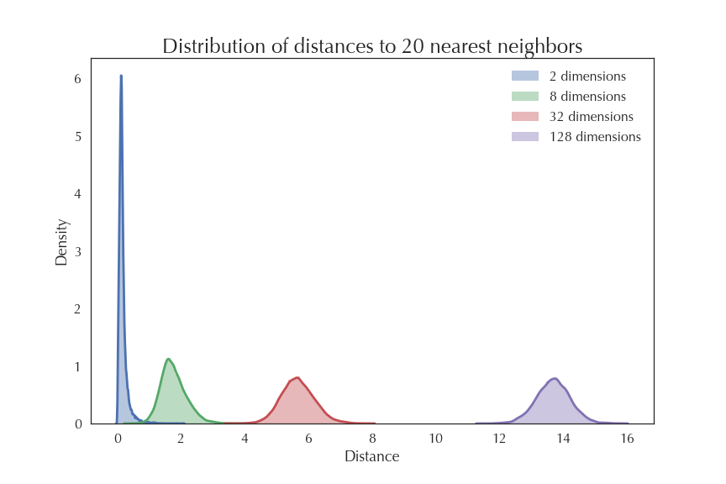

Slide 255
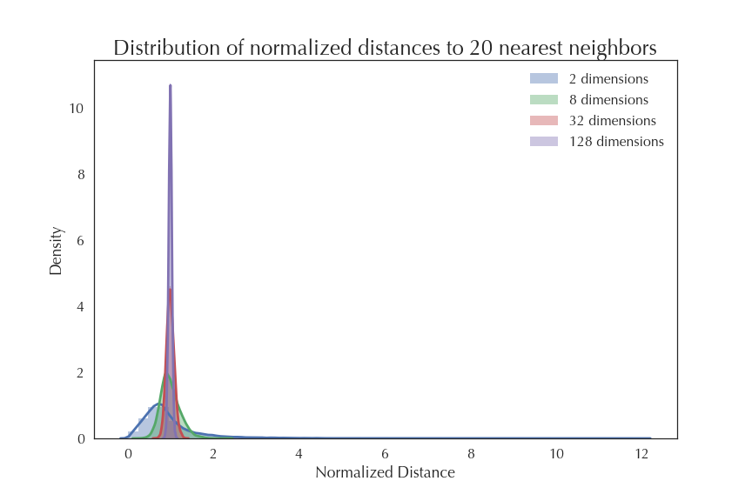

Slide 256
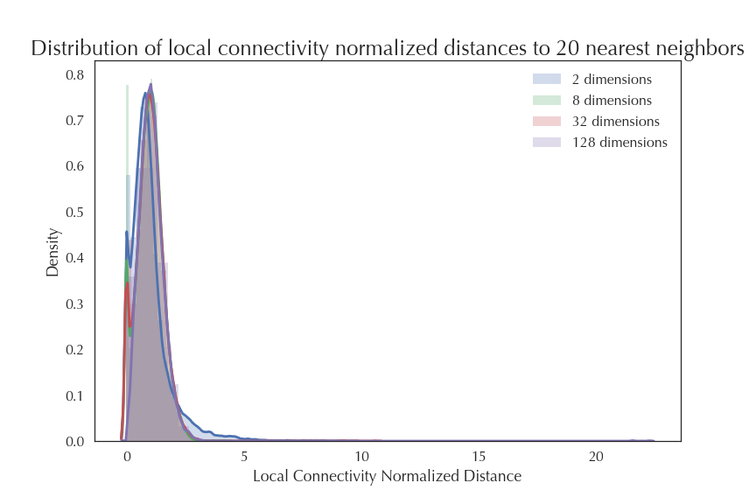

Slide 257
But our local metrics are all incompatible!

Slide 259
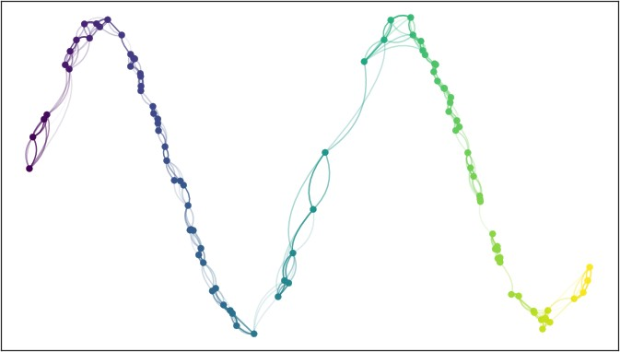

Slide 260
Theorem 2 (UMAP Adjunction). The functors FinReal : sFuzz ! FinEPMet and FinSing : FinEPMet ! sFuzz form an adjunction FinReal a FinSing.

Slide 261
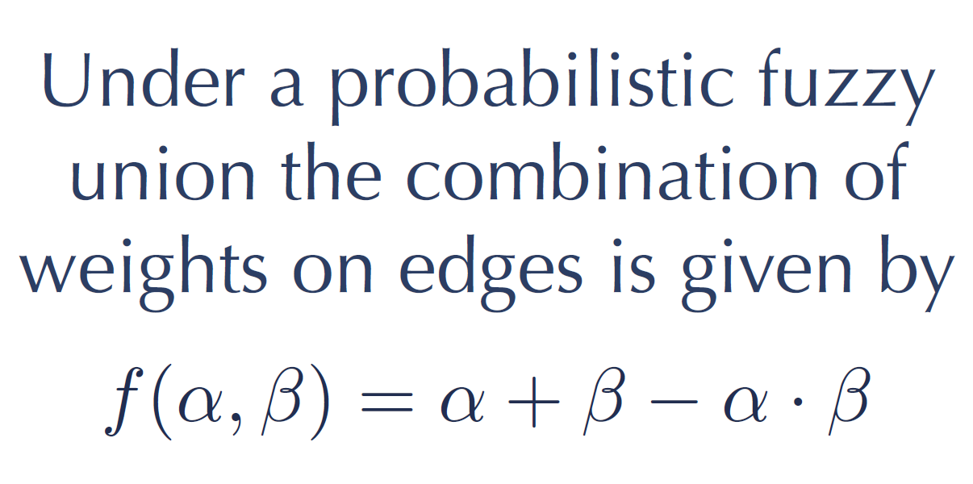

Slide 262
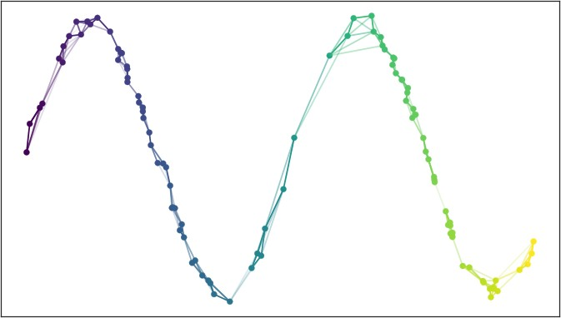

Slide 263
Suppose we were given a low dimensional representation

Slide 264
We can apply the same process to get a fuzzy graph!

Slide 265
Except we know the manifold, and don’t
know the “correct” nearest neighbour distance

Slide 266
Now measure the distance between the graphs using cross- entropy and optimize

Slide 267
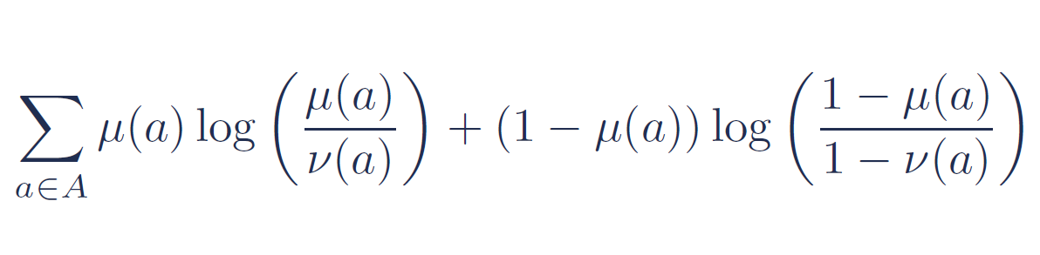

Slide 268
We are just embedding the graph

Slide 269
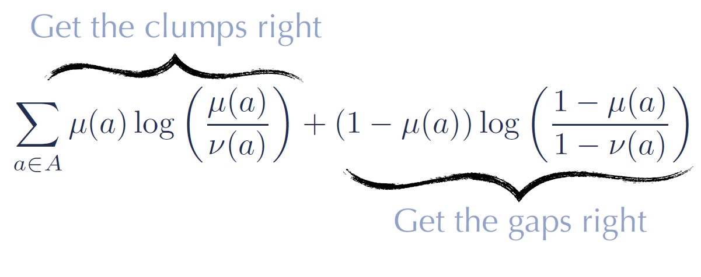

Slide 270


Slide 271


Slide 273
On real data?

Slide 274

UMAP on MNIST digits

Slide 275

UMAP on Fashion MNIST

Slide 276


+

Slide 277



Slide 278


Slide 279


Derived from Adam Bielski’s Siamese/Triplet repository: https://github.com/adambielski/siamese-triplet

Slide 280
Sources
SVD: http://cs246.stanford.edu
t-SNE: https://github.com/Divyagash/t-SNE/blob/master/tSNE_Presentation.pdf
https://statquest.org/2017/09/18/statquest-t-sne-clearly-explained/
UMAP: https://www.youtube.com/watch?v=nq6iPZVUxZU

Slide 281
How to Compute SVD

Slide 282

Finding Eigenpairs
How the SVD is actually computed?
First we need a method for finding the principal eigenvalue (the largest one) and the corresponding eigenvector of a symmetric matrix
$M$ is symmetric if $mij = mji$ for all $i$ and $j$
Method:
Start with any “guess eigenvector” $x0$
Construct $x_{k+1}=\frac{Mx_{k}}{|\left|Mx_{k}\right||}$ for $k = 0, 1,…$
$||…||$ denotes the Frobenius norm
Stop when consecutive $xk$ show little change

Slide 283
Example: Iterative Eigenvector
2
2 3
1
1
M =
x₀ =
Mx₀
3
5
0.51
0.86
=
/√34
=
=
x₁
||Mx₀||
Mx₁
2.23
3.60
0.53
0.85
=
/√17.93
=
=
x₂
||Mx₁||
…..

Slide 284

Finding the Principal Eigenvalue
Once you have the principal eigenvector $x$, you find its eigenvalue $$ by $ = xTMx$.
In proof: We know $x = Mx$ if $$ is the eigenvalue; multiply both sides by $xT$ on the left.
Since $xTx = 1$we have $ = xTMx$
Example: If we take x^{T} = [0.53, 0.85], then λ =
[
]
[
]
2
2 3
0.53
0.85
[0.53 0.85]
= 4.25

Slide 285

Finding More Eigenpairs
Eliminate the portion of the matrix $M$ that can be generated by the first eigenpair, λ and $x$:
$$M^{∗}:= M –λ x xT$$
Recursively find the principal eigenpair for $M^{∗}$, eliminate the effect of that pair, and so on
Example:
[
]
[
0.53
0.85
]
[
-0.19 0.09
0.09 0.07
]
M* =
2
2 3
– 4.25
[0.53 0.85]
=

Slide 286

How to Compute the SVD
Start by supposing $A = UVT$
$AT = (UVT)T = (VT)TTUT = VUT$
Why? (1) Rule for transpose of a product; (2) the transpose of the transpose and the transpose of a diagonal matrix are both the identity function
$ATA = VUTUVT = V2VT$
Why? $U$ is orthonormal, so $UTU$ is an identity matrix
Also note that $2$ is a diagonal matrix whose $i$-th element is the square of the $i$-th element of $$
$ATAV = V2VTV = V2$
Why? $V$ is also orthonormal

Slide 287

Computing the SVD –(2)
Starting with $\left(ATA\right)V = VΣ2$
Note that therefore the $i$-th column of $V$ is an eigenvector of $ATA$, and its eigenvalue is the $i$-th element of $2$
Thus, we can find $V$ and Σ by finding the eigenpairs for $ATA$
Once we have the eigenvalues in Σ², we can find the singular values by taking the square root of these eigenvalues
Symmetric argument, $AAT$gives us $U$

Slide 288
SVD - Complexity
To compute the full SVD using specialized methods:
O(nm²) or O(n²m) (whichever is less)
But:
Less work, if we just want singular values
or if we want first k singular vectors
or if the matrix is sparse
Implemented in linear algebra packages like
LINPACK, Matlab, SPlus, Mathematica ...

